Slide 1
Smartphone Inventory System
Name: Tan Wei Keong B031610099
Nang Wei Lun B031610078
Lim Jiang Leong B031610144
Lecturer: Dr. Azah Kamilah binti Draman

Slide 2
PROBLEM STATEMENT
The flow of the system was inefficient.
Staffs hard to record their data correctly.
Time consuming by calculating the total price of the items.

Slide 3
OBJECTIVES
To develop a systematic system that help the transaction running efficiently.
To build a database in order to record the data correctly and efficiently.
To develop a system to reduce time consuming in calculating the total price of the items and total sales.

Slide 4
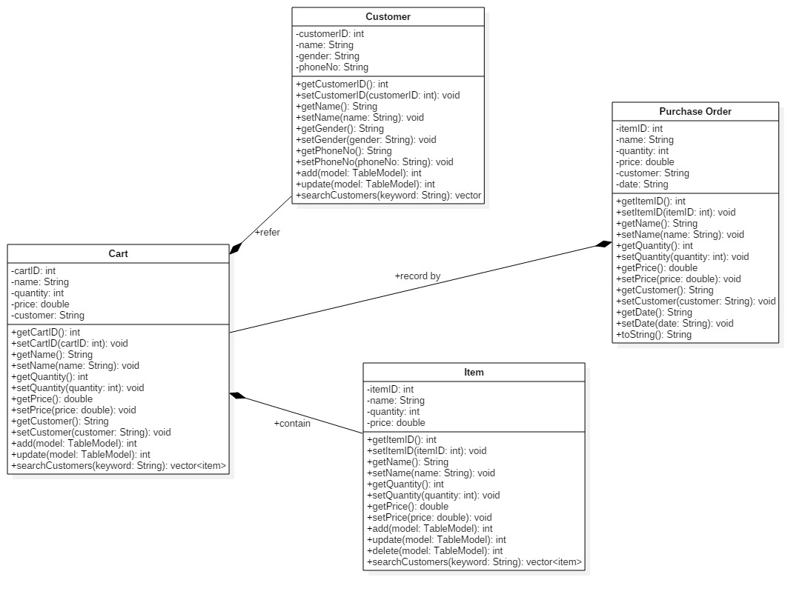
Class Diagram

Slide 5
DEMO

